Slide 1


Rubrik’s Cube:
Testing a New Rubric for Evaluating Explanations on the CUBE dataset
Diana Galvan-Sosa, Gabrielle Gaudeau, Pride Kavumba, Yunmeng Li, Hongyi Gu, Zheng Yuan, Keisuke Sakaguchi, Paula Buttery

Slide 2






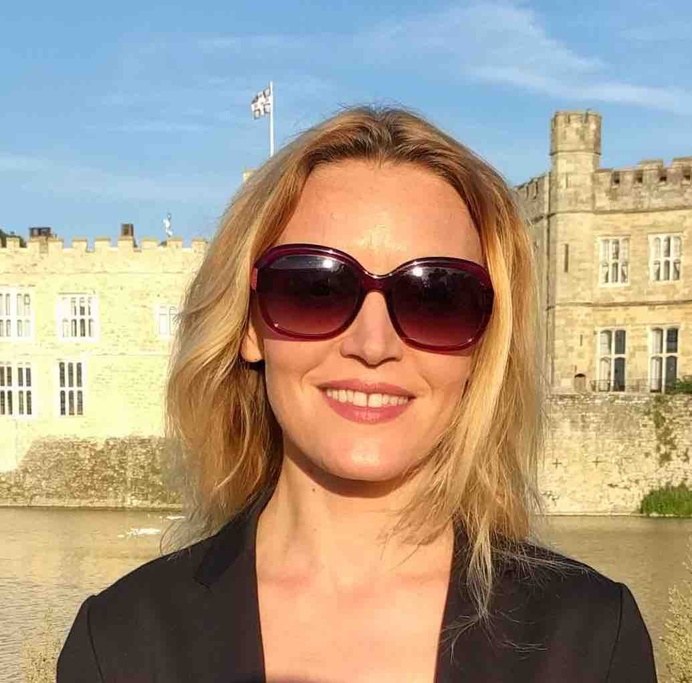






Diana Galvan-Sosa
Gabrielle Gaudeau
Pride Kavumba
Hongyi Gu
Yunmeng Li
Zheng Yuan
Keisuke Sakaguchi
Paula Buttery

Slide 3
Introduction
Large Language Models (LLMs) are increasingly being used in tasks which require a break down of their decision-making process (e.g., automated scoring, question generation, problem resolution; García-Méndez et al., 2024).
Though easy to generate, LLM explanations fall short due for being unreliable (Kim et al., 2024), lacking transparency (Sallam 2023; Kabir et al., 2024).
The challenge has shifted from generating explanations to assessing the quality of explanations.
3
Notes:
Main idea: explanations are diverse

Slide 4
Introduction
Explanations are diverse; there is usually more than one way of expressing the rationale behind a choice.
4
Notes:
Main idea: explanations are diverse

Slide 5
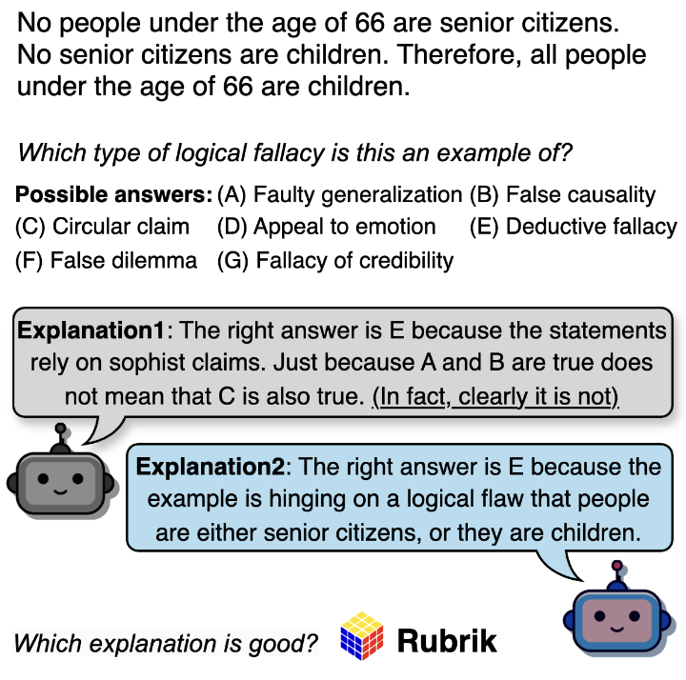
Introduction
Explanations are diverse; there is usually more than one way of expressing the rationale behind a choice.
4
Notes:
Main idea: explanations are diverse

Slide 6

Introduction
Common practice is to use human evaluators to assess their quality.
But these evaluations often rely on intuition, rather than formal definitions (Clark et al., 2021).
The following explanation is…
What makes it “good”?
Not good 👎 __ __ __ __ _ 👍 Good
This form of evaluation is not systematic and prone to inconsistency.
5

Slide 7
Our proposal
Rubrik: a rubric for explanation quality assessment.
Provides clear, consistent, and objective criteria for evaluation, following the rubric design principles set out by Dawson (2017).
Accounts for the diverse nature of explanations whilst also identifying common characteristics* among them.
Can easily be adapted to any task.
*Identified in different bodies of literature: cognitive and social sciences, XAI and NLG.
6

Slide 8
Methodology: Overview
Step 1: Rubric design → Rubrik
Step 2: Rubric validation → CUBE dataset
7

Slide 9



Methodology: Step 1
Type of explanation | Components necessary parts of an explanation that contribute to its completeness | Dimensions necessary linguistic or content feature of an explanation that contributes to its quality
 |  | Language | Content
 | 1.a) Action 1.b) Reason | Grammaticality Word Choice Cohesion | Conciseness Appropriateness Coherence
 | 2.a) Evidence |  | Plausibility
 | 3.a) Affective appeal(s) and Qualifier(s) |  | Stance Clarity
Rubrik
10

Slide 10
Methodology: Step 1
Type of explanation | Components necessary parts of an explanation that contribute to its completeness | Dimensions necessary linguistic or content feature of an explanation that contributes to its quality
 |  | Content | Language
 | 1.a) Action 1.b) Reason | Grammaticality Word Choice Cohesion | Conciseness Appropriateness Coherence
 | 2.a) Evidence |  | Plausibility
 | 3.a) Affective appeal(s) and Qualifier(s) |  | Stance Clarity
Hierarchical and nested:
Argument ⊆ Justification ⊆ Commentary
Lower
Goal: Understanding the underlying rationale
Goal: Persuading the audience
Higher
11

Slide 11
Methodology: Step 1
Type of explanation | Components necessary parts of an explanation that contribute to its completeness | Dimensions necessary linguistic or content feature of an explanation that contributes to its quality
 |  | Language | Content
 | 1.a) Action 1.b) Reason | Grammaticality Word Choice Cohesion | Conciseness Appropriateness Coherence
 | 2.a) Evidence |  | Plausibility
 | 3.a) Affective appeal(s) and Qualifier(s) |  | Stance Clarity
1
2
12

Slide 12
Methodology: Step 1
Type of explanation | Components necessary parts of an explanation that contribute to its completeness | Dimensions necessary linguistic or content feature of an explanation that contributes to its quality
 |  | Language | Content
 | 1.a) Action 1.b) Reason | Grammaticality Word Choice Cohesion | Conciseness Appropriateness Coherence
 | 2.a) Evidence |  | Plausibility
 | 3.a) Affective appeal(s) and Qualifier(s) |  | Stance Clarity
✅
✅
A commentary
13

Slide 13
Methodology: Step 1
Type of explanation | Components necessary parts of an explanation that contribute to its completeness | Dimensions necessary linguistic or content feature of an explanation that contributes to its quality
 |  | Language | Content
 | 1.a) Action 1.b) Reason | Grammaticality Word Choice Cohesion | Conciseness Appropriateness Coherence
 | 2.a) Evidence |  | Plausibility
 | 3.a) Affective appeal(s) and Qualifier(s) |  | Stance Clarity
✅
✅
✅
✅
✅
✅
✅
✅
Good commentary
13

Slide 14
Methodology: Step 1
Type of explanation | Components necessary parts of an explanation that contribute to its completeness | Dimensions necessary linguistic or content feature of an explanation that contributes to its quality
 |  | Language | Content
 | 1.a) Action 1.b) Reason | Grammaticality Word Choice Cohesion | Conciseness Appropriateness Coherence
 | 2.a) Evidence |  | Plausibility
 | 3.a) Affective appeal(s) and Qualifier(s) |  | Stance Clarity
✅
✅
✅
✅
✅
✅
✅
✅
✅
✅
A justification
14

Slide 15
Methodology: Step 1
Type of explanation | Components necessary parts of an explanation that contribute to its completeness | Dimensions necessary linguistic or content feature of an explanation that contributes to its quality
 |  | Language | Content
 | 1.a) Action 1.b) Reason | Grammaticality Word Choice Cohesion | Conciseness Appropriateness Coherence
 | 2.a) Evidence |  | Plausibility
 | 3.a) Affective appeal(s) and Qualifier(s) |  | Stance Clarity
✅
✅
✅
✅
✅
✅
✅
✅
✅
✅
Good justification
14

Slide 16
Methodology: Step 1
Type of explanation | Components necessary parts of an explanation that contribute to its completeness | Dimensions necessary linguistic or content feature of an explanation that contributes to its quality
 |  | Language | Content
 | 1.a) Action 1.b) Reason | Grammaticality Word Choice Cohesion | Conciseness Appropriateness Coherence
 | 2.a) Evidence |  | Plausibility
 | 3.a) Affective appeal(s) and Qualifier(s) |  | Stance Clarity
✅
✅
✅
✅
✅
✅
✅
✅
✅
✅
✅
✅
An argument
15

Slide 17
Methodology: Step 1
Type of explanation | Components necessary parts of an explanation that contribute to its completeness | Dimensions necessary linguistic or content feature of an explanation that contributes to its quality
 |  | Language | Content
 | 1.a) Action 1.b) Reason | Grammaticality Word Choice Cohesion | Conciseness Appropriateness Coherence
 | 2.a) Evidence |  | Plausibility
 | 3.a) Affective appeal(s) and Qualifier(s) |  | Stance Clarity
✅
✅
✅
✅
✅
✅
✅
✅
✅
✅
✅
✅
Good argument
15

Slide 18
Methodology: Step 2
Step 1: Rubric design → Rubrik
Explanation types (hierarchical and nested)
Quality dimensions
Step 2: Rubric validation → CUBE dataset
16

Slide 19
Methodology: Step 2
Commonsense Reasoning
Usual Fallacy Detection
Basic Reading Comprehension
Essay scoring
1. Data collection
4 Tasks
17

Slide 20







Methodology: Step 2
Commonsense Reasoning
Usual Fallacy Detection
Basic Reading Comprehension
Essay scoring
1. Data collection
4 Tasks
2. Explanation Generation
6 LLMs (4 open, 2 closed)
7 annotators (4 contractors, 3 experts)
+
19

Slide 21
Methodology: Step 2
Commonsense Reasoning
Usual Fallacy Detection
Basic Reading Comprehension
Essay scoring
1. Data collection
4 Tasks
2. Explanation Generation
6 LLMs (4 open, 2 closed)
7 annotators (4 contractors, 3 experts)
+
1 ,000 explanations/LLM/task = 24,000
110 explanations/contractor/task + 110 explanations/expert/tasks 3&4 = 2,420
Total = 26,420 explanations
19

Slide 22
Methodology: Step 2
Commonsense Reasoning
Usual Fallacy Detection
Basic Reading Comprehension
Essay scoring
1. Data collection
4 Tasks
2. Explanation Generation
6 LLMs (4 open, 2 closed)
7 annotators (4 contractors, 3 experts)
+
1 ,000 explanations/LLM/task = 24,000
110 explanations/contractor/task + 110 explanations/expert/tasks 3&4 = 2,420
Total = 26,420 explanations
3. Explanation assessment
2 evaluators
1 LLM
19

Slide 23
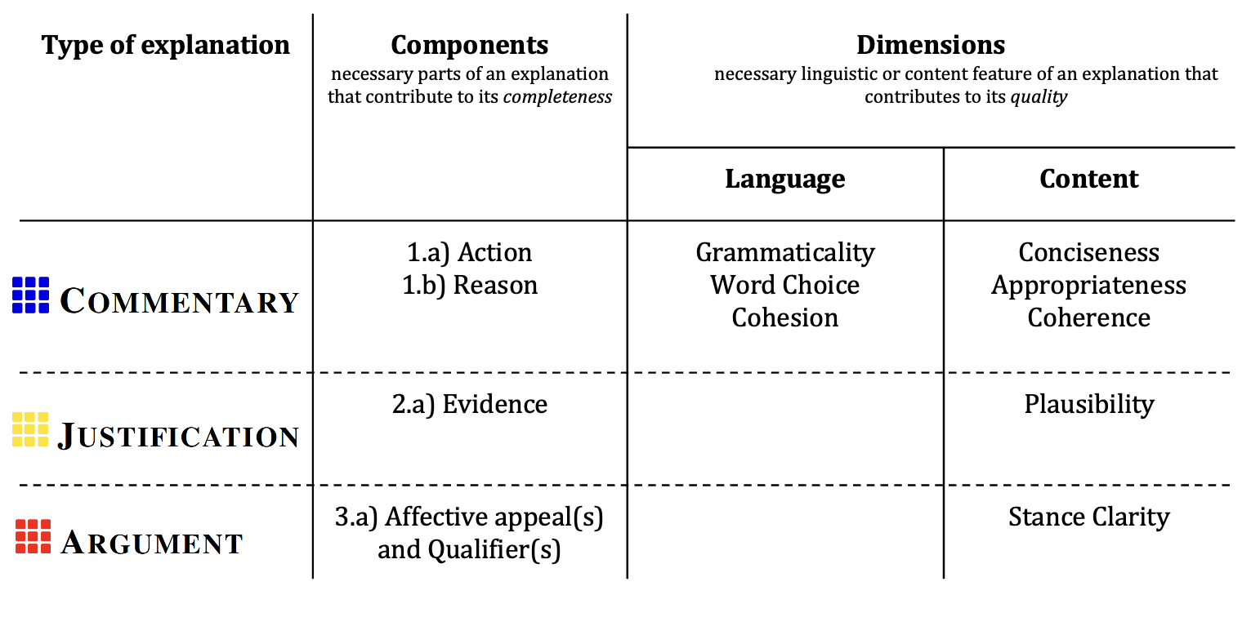
Explanation assessment: Essay Scoring
Essay:
Explanation:
The right answer is A, because this text is clearly of a low english level, with mis-conjugations of 'i do a research' and 'this are findings', alongside 'our litters' and 'whenever' instead of 'wherever' show a poor grasp of language. The expression in the final section is very heartfelt however, and the tone is excitable and keen throughout.
To: International organisation
From: Dimitris Barberis
Subject: Our green town
Introduction
The aim of the report is to write how are town take care of the environment. I do a research and this are findings.
Rubbish
We have a lot of bins around the area, so now we can throw our litters whenever we are. Also we have recycle bins for paper and glass.
Cleaners
Every Saturday our local cleaning team clean the park and now everyone can enjoy it!
Conclusion
We do everything to make our town more green, our citizens always have new ideas that make the difference of our daily life.
20

Slide 24
Explanation assessment: Essay Scoring
Essay:
Explanation:
The right answer is A, because this text is clearly of a low english level, with mis-conjugations of 'i do a research' and 'this are findings', alongside 'our litters' and 'whenever' instead of 'wherever' show a poor grasp of language. The expression in the final section is very heartfelt however, and the tone is excitable and keen throughout.
→ GOOD!
To: International organisation
From: Dimitris Barberis
Subject: Our green town
Introduction
The aim of the report is to write how are town take care of the environment. I do a research and this are findings.
Rubbish
We have a lot of bins around the area, so now we can throw our litters whenever we are. Also we have recycle bins for paper and glass.
Cleaners
Every Saturday our local cleaning team clean the park and now everyone can enjoy it!
Conclusion
We do everything to make our town more green, our citizens always have new ideas that make the difference of our daily life.
20

Slide 25
Methodology: Step 2
Commonsense Reasoning (HellaSWAG)
Usual Fallacy Detection (LOGIC)
Basic Reading Comprehension (RACE)
Essay scoring (Write & Improve, BEA’19)
1. Data collection
4 Tasks
2. Explanation Generation
6 LLMs (4 open, 2 closed)
7 annotators (4 contractors, 3 experts)
+
1 ,000 explanations/LLM/task = 24,000
110 explanations/contractor/task + 110 explanations/expert/tasks 3&4 = 2,420
Total = 26,420 explanations
3. Explanation assessment
2 evaluators
1 LLM
920 explanations jointly assessed by the LLM and human evaluators.
4,140 explanations assessed by the LLM only.
Total = 5,060 explanations assessments.
22

Slide 26
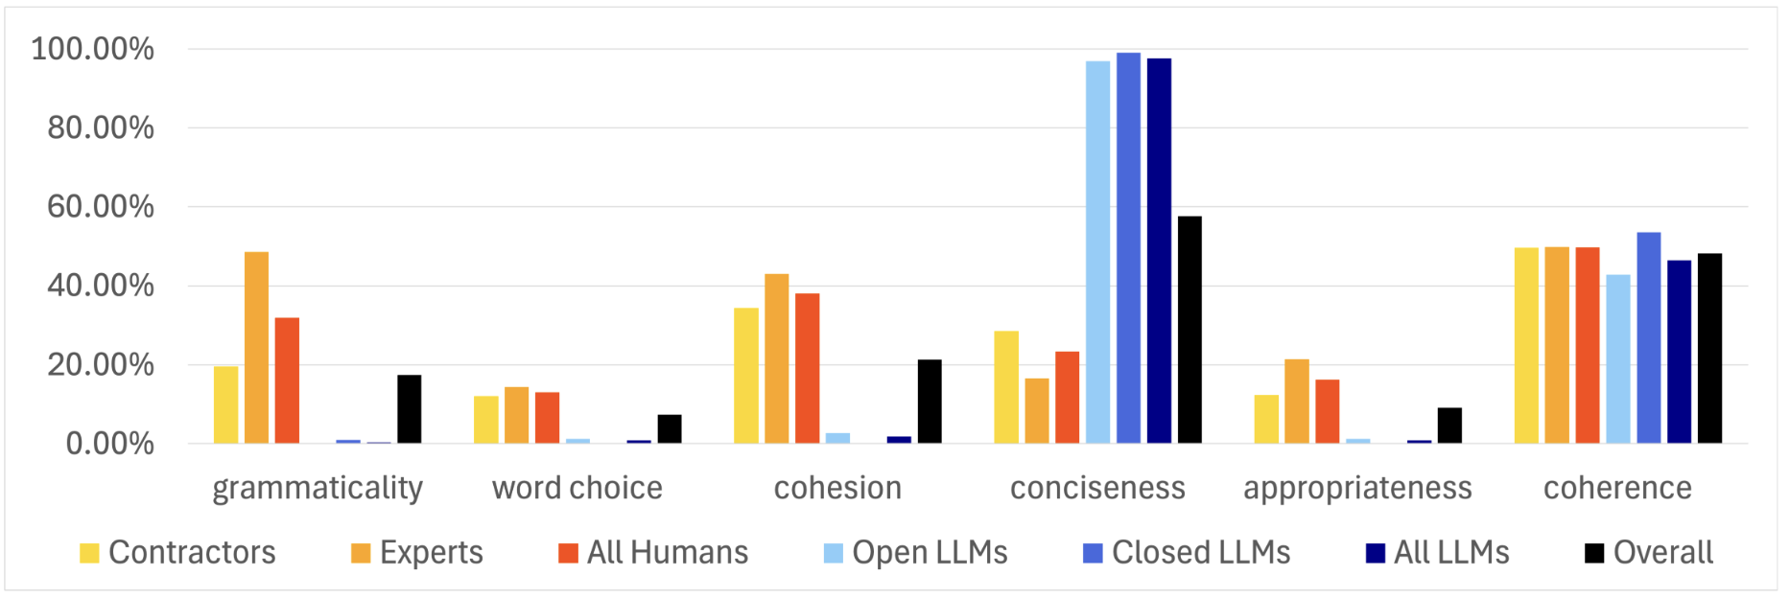
Results: Source of bad commentaries
Low-quality LLM explanations are due to lack of conciseness.
23
Notes:
The most obvious observation from this figure is the high frequency of CONCISENESS as the reason why an explanation generated by either of the LLMs is judged to be bad.
This contrasts with the low frequency of WORD CHOICE, COHESION, APPROPRIATENESS and GRAMMATICALITY.
On the other hand, CONCISENESS less of a problem to humans, whose explanations are mostly judged as bad due to poor COHERENCE.
In the particular case of experts, it is interesting to see their explanations are less grammatical than then contractors.

Slide 27
Further Results
The types of explanations varied depending on task difficulty (e.g., more arguments in essay scoring).
Task accuracy and our typology correlate (e.g. justifications coincided with higher task accuracy as opposed to commentaries).
LLMs and humans tend to output justifications (i.e. providing evidence).
Our results demonstrate the usefulness of our rubric.
24

Slide 28
Conclusion
To address the lack of widely-agreed definition of what constitutes a good explanation, we propose:
Rubrik, a general-purpose rubric for evaluating the quality of LLM-generated and human-written explanations.
CUBE, a dataset of 26k explanations written by both humans and LLMs across four tasks (Commonsense Reasoning, Fallacy Detection, Reading Comprehension, Essay Scoring), to validate the rubric.
We hope to advance explanation quality assessment in the future.
25

Slide 29
Thank you!
Contact us: dg693@cam.ac.uk, gjg34@cam.ac.uk

